Slide 1
Computer Organization and Assembly Fall 2019
Lecture 16 & 17
Syeda Farwa Batool

Slide 2
LES Instruction
LES loads ES.
It have two parameters, one is the general purpose register to be loaded and the other Is the memory location from which to load these registers.
For example
Les di, [offsetValueANDSegmentValue] ;
; this is do following work
Mov di, [offsetValueANDSegmentValue]
Mov es, [offsetValueANDSegmentValue + 2]

Slide 3
LDS Instructions
LDS loads DS.
It have two parameters, one is the general purpose register to be loaded and the other Is the memory location from which to load these registers.
For example
Lds si, [offsValueANDSegmentValue] ;
; this is do following work
Mov si, [offsValueANDSegmentValue]
Mov ds, [offsValueANDSegmentValue + 2]

Slide 4
LES Instructions
LES loads ES.
It have two parameters, one is the general purpose register to be loaded and the other Is the memory location from which to load these registers.
For example
Lds Di, [offsValueANDSegmentValue] ;
; this is do following work
Mov Di, [offsValueANDSegmentValue]
Mov ES, [offsValueANDSegmentValue + 2]

Slide 5
Class Activity
Write a subroutine that receives 5 values, offset and segment of string1 and then offset and segment of string2 respectively and then length of strings (assume both strings are equal). Function will return 1 if string1 and string2 are equal other wise zero.
C++ version can be
bool compare(int str1_seg, int str1_offset, int str2_seg, int str2_offset, length )

Slide 6






Scroll Down Screen
; scroll down the screen
[org 0x0100]
start:
mov ax,5
push ax ; push number of lines to scroll
call scrolldown ; call scroll down subroutine
mov ax, 0x4c00 ; terminate program
int 0x21

Slide 7



; subroutine to scrolls down the screen
; take the number of lines to scroll as parameter
scrolldown:
push bp
mov bp,sp
push es
push ds
mov ax, 80 ; load chars per row in ax
mul byte [bp+4] ; calculâtes source position
push ax ; save position for later use ;; store result for future use
shl ax, 1 ; convert to byte offset
400
Value of ds
Value of es
;; AX = 5*80 = 400
;; AX = 400 * 2 = 800

Slide 8
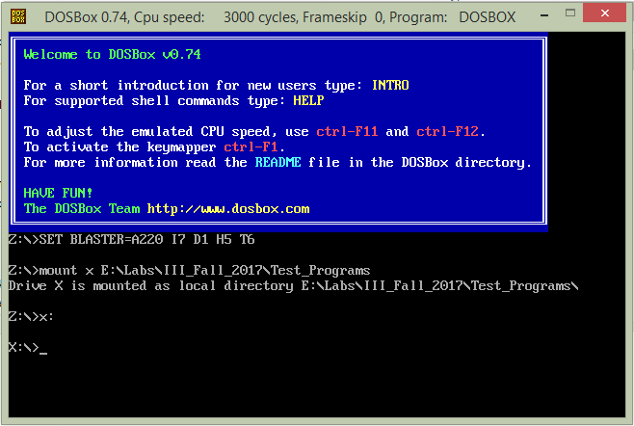
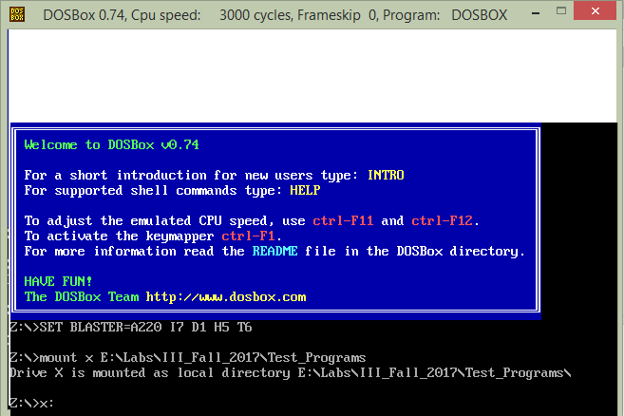
mov si, 3998 ; last location on the screen
sub si, ax ; load source position in si
mov cx, 2000 ; number of screen locations
sub cx, ax ; count of words to move
;; means don’t copy 5 rows data
;; so subtract it from total
mov ax, 0xb800
mov es, ax ; point es to video base
mov ds, ax ; point ds to video base
mov di, 3998 ; point di to lower right column
std ; set auto decrement mode
rep movsw ; scroll up
ES
DS
SI
5 rows
SI
DI
SI
DI

Slide 9
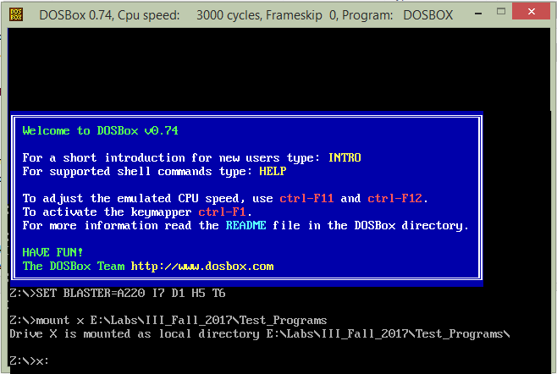
mov ax, 0x0720 ; space in normal attribute
pop cx ; count of positions to clear
;; cx = 400
;; copy 400 spaces on destination
rep stosw ; clear the scrolled space
pop ds
pop es
pop bp
ret 2
DI
DI

Slide 10
What is an interrupt
In interrupt is an event which can occur whiling any computer is running.
Interrupts in reality are events that occurred outside the processor and the processor must be informed about them. Interrupts are asynchronous and unpredictable. Asynchronous means that the interrupts occur, independent of the working of the processor, i.e. independent of the instruction currently executing.
The two concepts of being unpredictable and asynchronous are overlapping. Unpredictable means the time at which an interrupt will come cannot be predicted, while asynchronous means that the interrupt has nothing to do with the currently executing instruction and the current state of the processor.

Slide 11
Types of Interrupts
Hardware interrupts
They are the real interrupts generated by the external world as discussed above.
Software interrupts
They are not generated from outside the processor. They just provide an extended far call mechanism. Far call allows us to jump anywhere in the whole megabyte of memory. To return from the target we place both the segment and offset on the stack. Software interrupts show a similar behavior. It however pushes one more thing before both the segment and offset and that is the FLAGS register.

Slide 12
How an interrupt occurs
int command is used to call an interrupt.
Each interrupt has an number or ID
So, if someone wants to call interrupt number 10, then it can be written as:
Then your current execution of code stops, just like in function call case. And IP moves towards the execution of interrupt number 10.
int 10

Slide 13
Interrupt Service Routine (ISR)
ISR is subroutine of any interrupt.
For example
{my code}
[org 0x0100]
mov ax,1234
mov bx, 234
add ax ,bx
int 10
{ISR of int 10}
;;; Some code is written here ;;; to handle int 10
Complete flag register
Current Value of CS
Current Value of IP

Slide 14
Interrupt Vector Table (IVT)
Interrupt Vector table is a table where interrupt number are save with their ISR address.
Interrupt Number | Offset value of ISR (each offset takes 2 bytes) | Segment Value of ISR (each segment takes 2 bytes
0 | XXXX | XXXX
1 | XXXX | XXXX
2 | XXXX | XXXX
3 | XXXX | XXXX
…….. | XXXX | XXXX
Location of IVT is 0th location of a 0th segment
Means 0:0 this place has IVT
What will be location of int 2 offset?
2*4 = 8
What will be location of int 4 segment?
4 * 4 + 2 = 18

Slide 15
Change in IVT (Hooking in interrupt)

